Slide 1
Digital Signature

Slide 2
Objectives
To define a digital signature
To define security services provided by a digital
signature
To define attacks on digital signatures
To discuss some digital signature schemes, including
RSA, ElGamal,
DSS
To describe some applications of digital signatures

Slide 3
Digital Signature
According to ISO, the term Digital Signature is used: ‘to indicate a particular authentication technique used to establish the origin of a message in order to settle disputes of what message (if any) was sent’.
A signature on a message is some data that
  validates a message and verifies its origin
  a receiver can keep as evidence
  a third party can use to resolve disputes.

Slide 4
Inclusion
A conventional signature is included in the document; it is part of the document. But when we sign a document digitally, we send the signature as a separate document.
Verification Method
For a conventional signature, when the recipient receives a document, she compares the signature on the document with the signature on file. For a digital signature, the recipient receives the message and the signature. The recipient needs to apply a verification technique to the combination of the message and the signature to verify the authenticity.

Slide 5
Relationship
For a conventional signature, there is normally a one-to-many relationship between a signature and documents. For a digital signature, there is a one-to-one relationship between a signature and a message.
Duplicity
In conventional signature, a copy of the signed document can be distinguished from the original one on file. In digital signature, there is no such distinction unless there is a factor of time on the document.

Slide 6
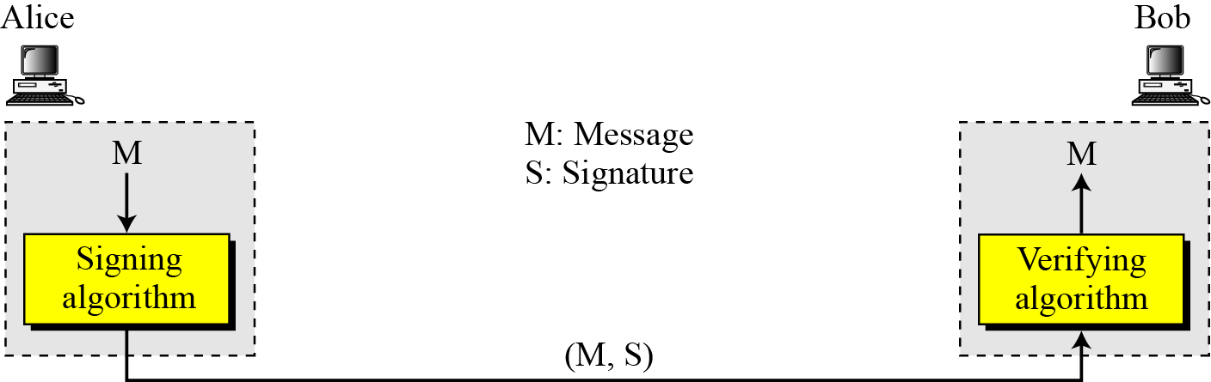
The Process
The sender uses a signing algorithm to sign the message. The message and the signature are sent to the receiver. The receiver receives the message and the signature and applies the verifying algorithm to the combination. If the result is true, the message is accepted; otherwise, it is rejected.

Slide 7
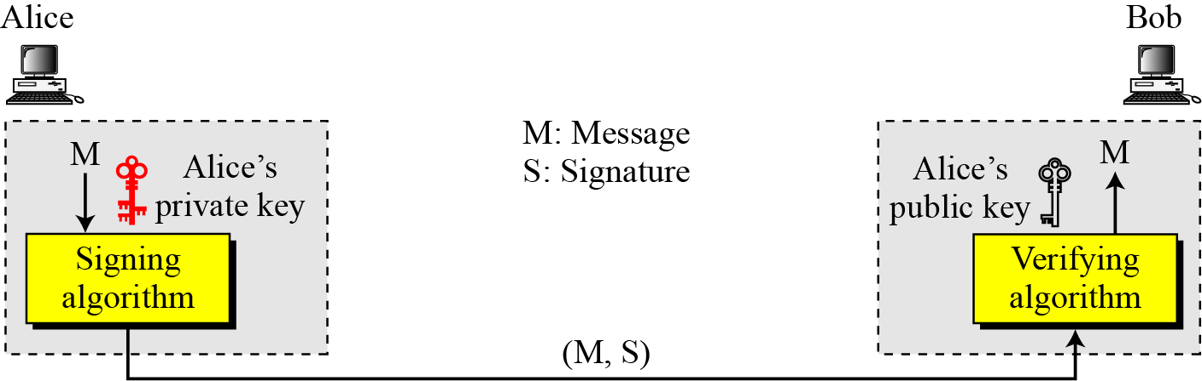
The Process
A digital signature needs a public-key system. The signer signs with her private key; the verifier verifies with the signer’s public key.
A cryptosystem uses the private and public keys of the receiver: a digital signature uses the private and public keys of the sender.

Slide 8
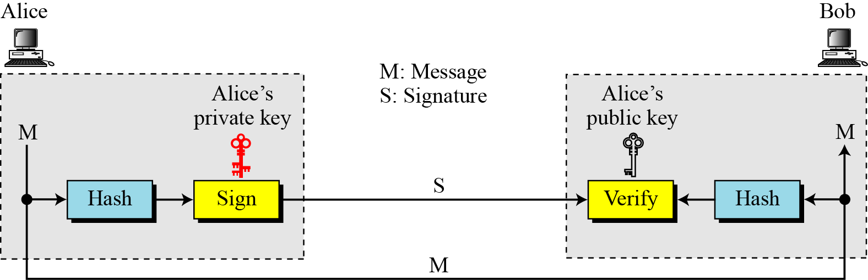
Signing the Digest

Slide 9
Security Services
User Authentication: A secure digital signature scheme, like a secure conventional signature can provide message authentication
Data Integrity: The integrity of the message is preserved even if we sign the whole message because we cannot get the same signature if the message is changed.
Non-repudiation
Confidentiality

Slide 10
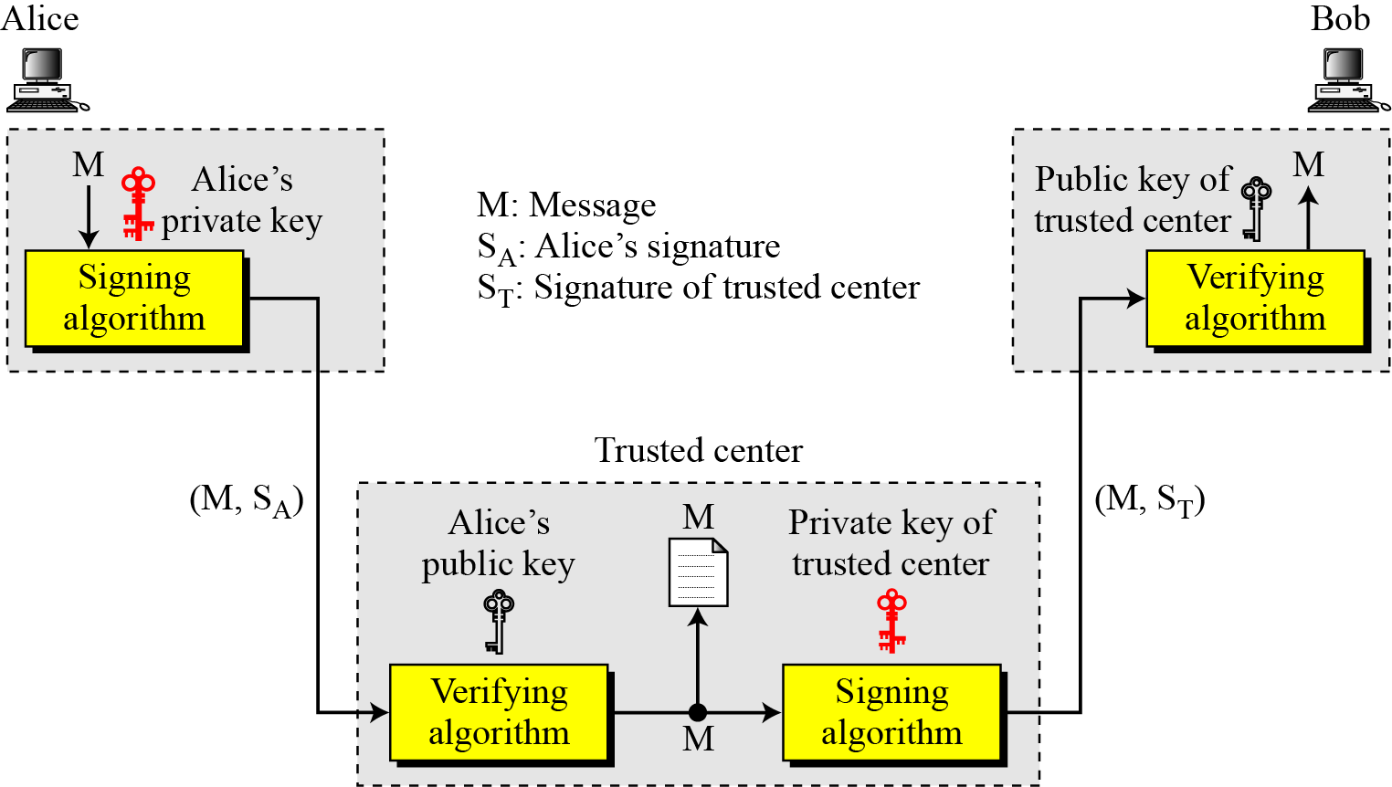
Non repudiation
Non-repudiation can be provided using a trusted party.

Slide 11
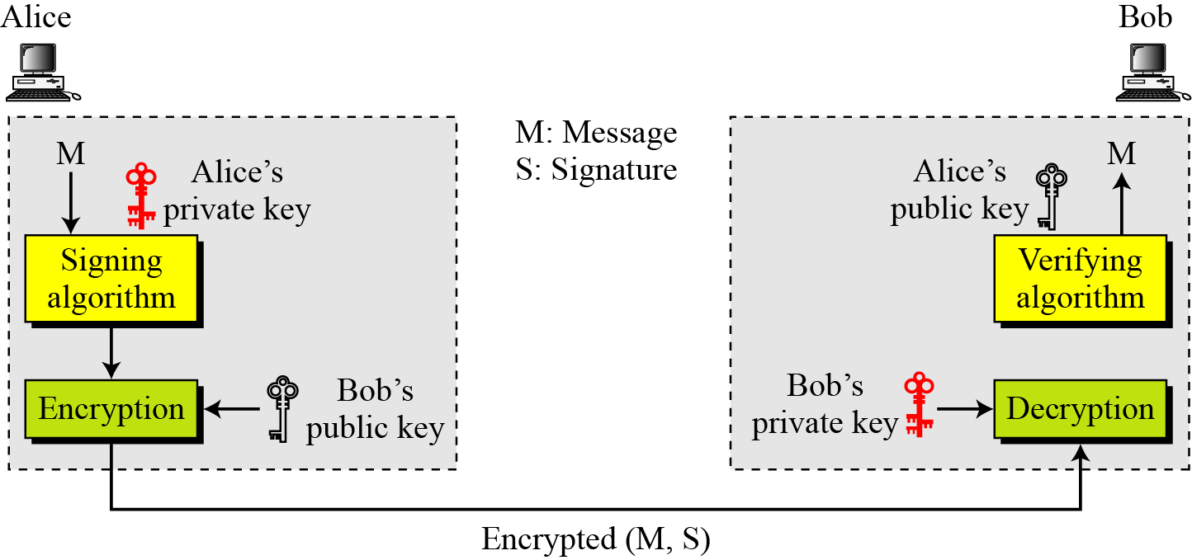
Confidentiality
Adding confidentiality to a digital signature scheme
A digital signature does not provide privacy. If there is a need for privacy, another layer of encryption/decryption must be applied.

Slide 12
Digital Signature Schemes
Several digital signature schemes have evolved during the last few decades. Some of them have been implemented.
RSA Digital Signature Scheme
ElGamal Digital Signature Scheme
Schnorr Digital Signature Scheme
Digital Signature Standard (DSS)
Elliptic Curve Digital Signature Scheme

Slide 13
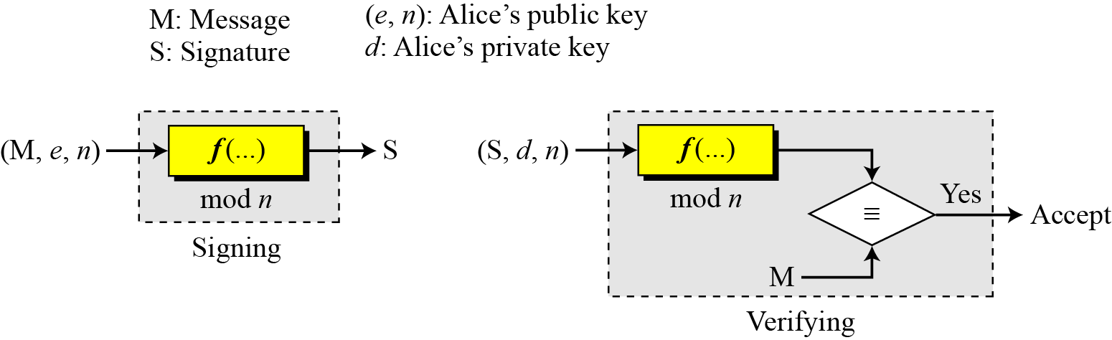
RSA Digital Signature Scheme
General idea behind the RSA scheme
Key generation in the RSA digital signature scheme is exactly the same as key generation in the RSA
In the RSA digital signature scheme, d is private; e and n are public.

Slide 14
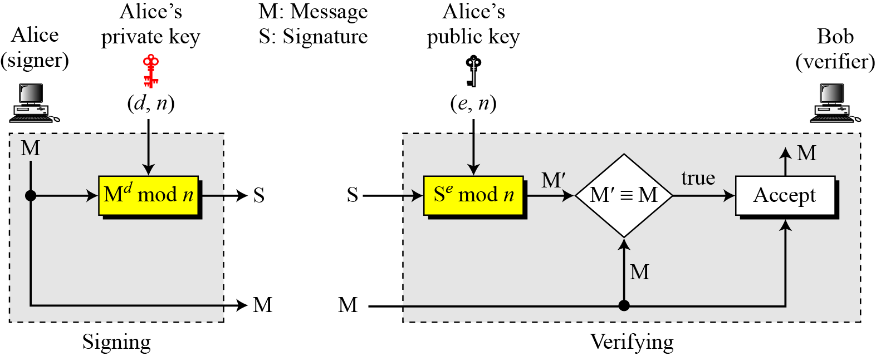
Signing and Verifying
RSA digital signature scheme

Slide 15
Example
As a trivial example, suppose that Alice chooses p = 823 and q = 953, and calculates n = 784319. The value of φ(n) is 782544. Now she chooses e = 313 and calculates d = 160009. At this point key generation is complete. Now imagine that Alice wants to send a message with the value of M = 19070 to Bob. She uses her private exponent, 160009, to sign the message:
Alice sends the message and the signature to Bob. Bob receives the message and the signature. He calculates
Bob accepts the message because he has verified Alice’s signature.

Slide 16
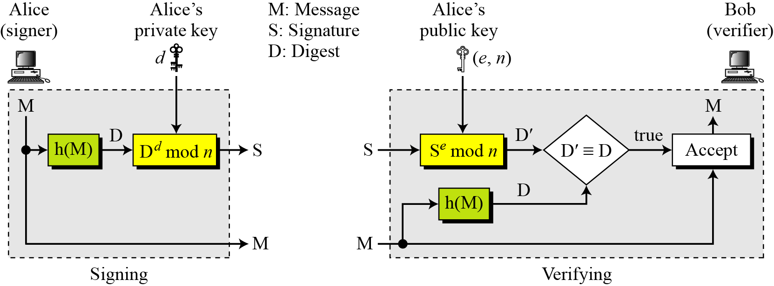
RSA Signature on the Message Digest
When the digest is signed instead of the message itself, the susceptibility of the RSA digital signature scheme depends on the strength of the hash algorithm.

Slide 17
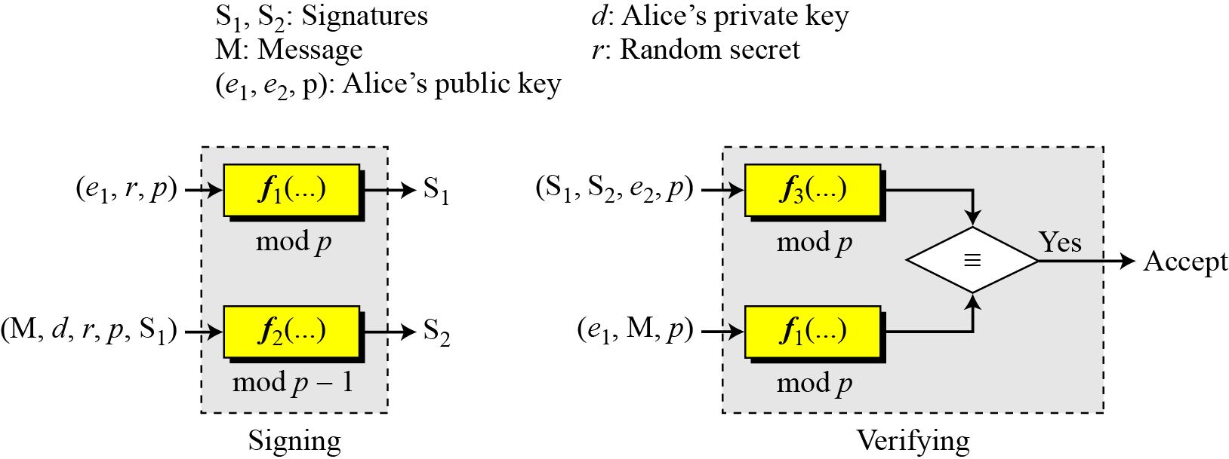
ElGamal Digital Signature Scheme
The key generation procedure here is exactly the same as the one used in the cryptosystem.
In ElGamal digital signature scheme, (e1, e2, p) is Alice’s public key; d is her private key.

Slide 18
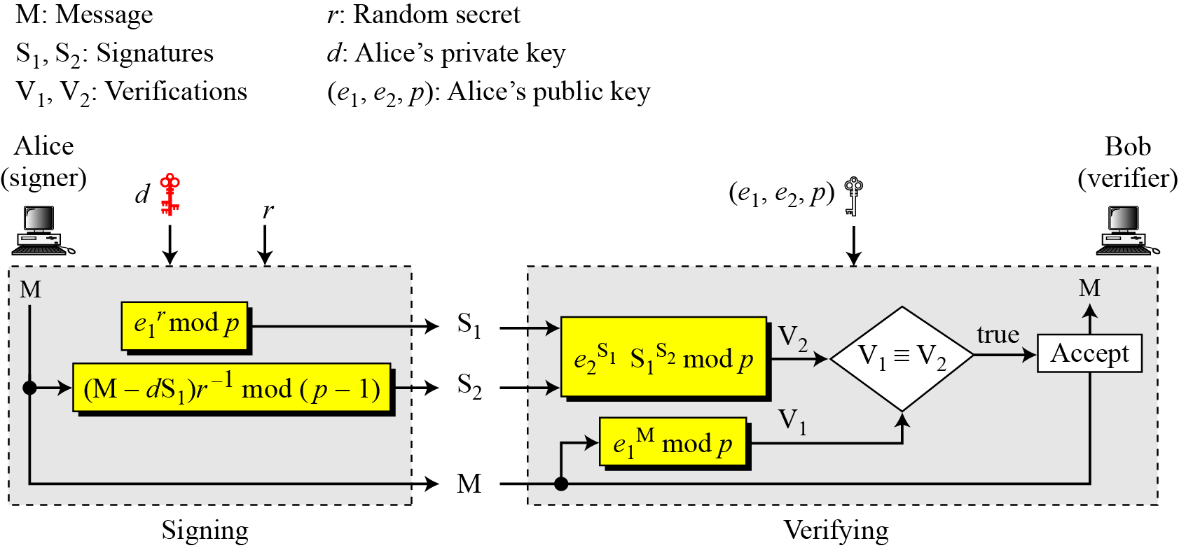
Verifying and Signing
ElGamal digital signature scheme

Slide 19
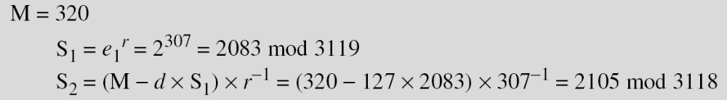
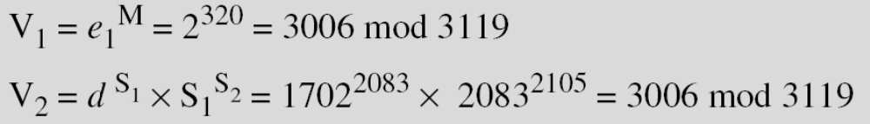
Example
Here is a trivial example. Alice chooses p = 3119, e₁ = 2, d= 127 and calculates e₂ = 2¹²⁷ mod 3119 = 1702. She also chooses r to be 307. She announces e1, e2, and p publicly; she keeps d secret. The following shows how Alice can sign a message.
Alice sends M, S₁, and S₂ to Bob. Bob uses the public key to calculate V₁ and V₂.

Slide 20
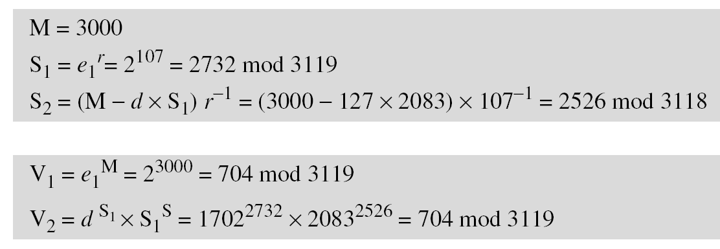
Example
Now imagine that Alice wants to send another message, M = 3000, to Ted. She chooses a new r, 107. Alice sends M, S₁, and S₂ to Ted. Ted uses the public keys to calculate V₁ and V₂.

Slide 21
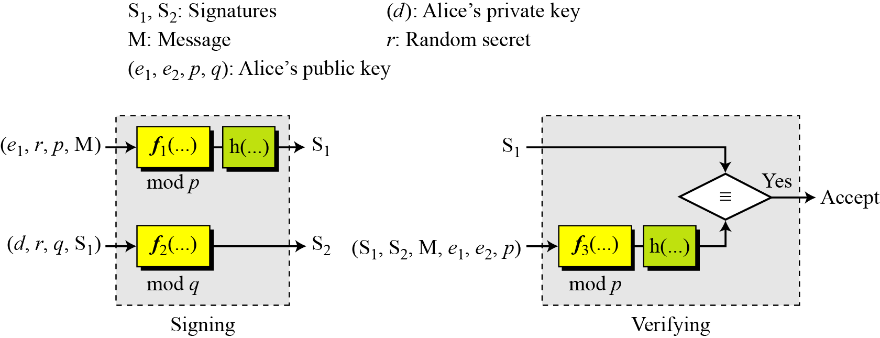
Schnorr Digital Signature Scheme

Slide 22
Key Generation
Alice selects a prime p, which is usually 1024 bits in length.
Alice selects another prime q; such that (p-1)/q = 1.
Alice chooses e₁ to be the qth root of 1 modulo p.
Alice chooses an integer, d, as her private key.
Alice calculates e₂ = e₁^{d} mod p.
Alice’s public key is (e₁, e₂, p, q); her private key is (d).
In the Schnorr digital signature scheme, Alice’s public key is (e1, e2, p, q); her private key (d).

Slide 23
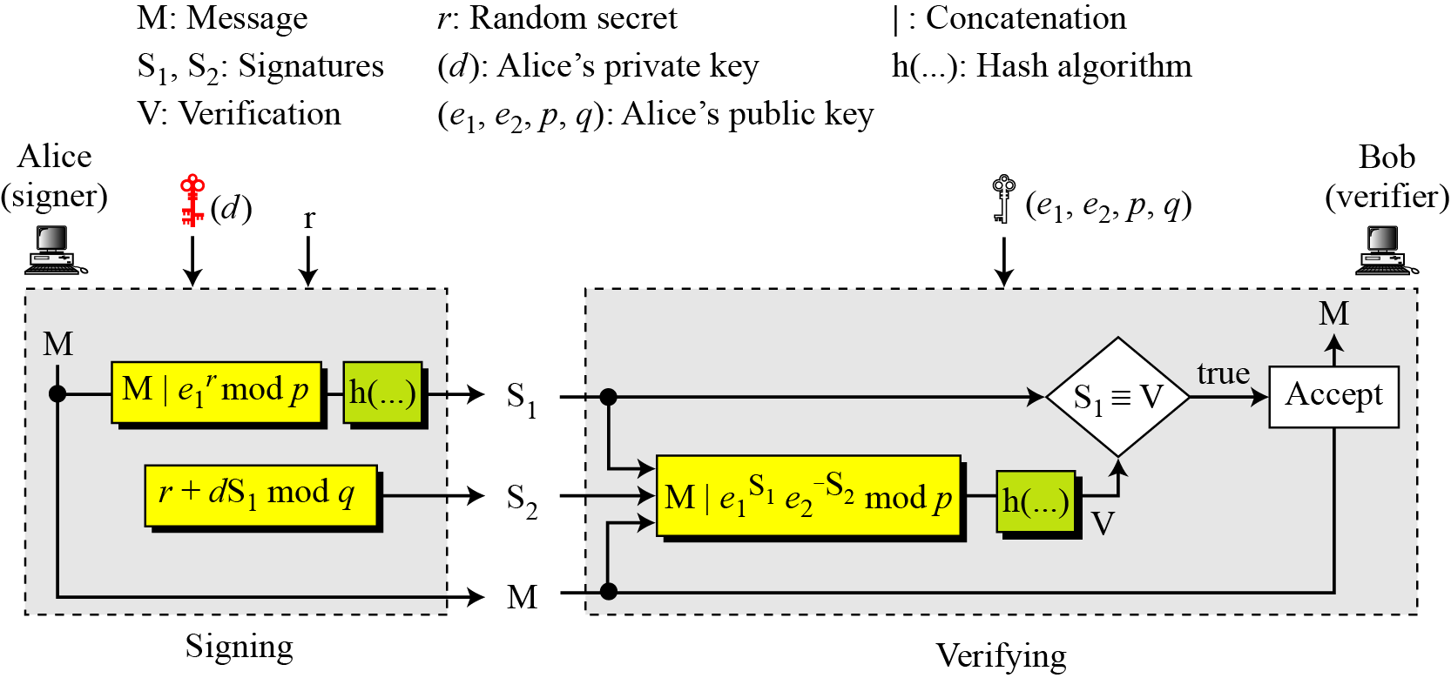
Signing and Verifying
Schnorr digital signature scheme

Slide 24
Schnorr Scheme
Signing
1. Alice chooses a random number r.
2. Alice calculates S₁ = h(M|e₁^{r} mod p).
3. Alice calculates S₂ = r + d × S₁ mod q.
4. Alice sends M, S₁, and S₂.
Verifying Message
1. Bob calculates V = h (M | e₁^{S2} e₂^{−S1} mod p).
2. If S₁ is congruent to V modulo p, the message is accepted;

Slide 25
Example
Here is a trivial example. Suppose we choose q = 103 and p = 2267. Note that p = 22 × q + 1. We choose e₀ = 2, which is a primitive value. Then (p −1) / q = 22, so we have e₁ = 2²² mod 2267 = 354. We choose d = 30, so e₂ = 354³⁰ mod 2267 = 1206. Alice’s private key is now (d); her public key is (e₁, e₂, p, q).
Alice wants to send a message M. She chooses r = 11 and calculates e₁ ^{r} = 354¹¹ = 630 mod 2267. Assume that the message is 1000 and concatenation means 1000630. Also assume that the hash of this value gives the digest h(1000630) = 200. This means S1 = 200. Alice calculates S2 = r + d × S₁ mod q = 11 + 1026 × 200 mod 103 = 35. Alice sends the message M =1000, S₁ = 200, and S₂ = 35. The verification is left as an exercise.

Slide 26
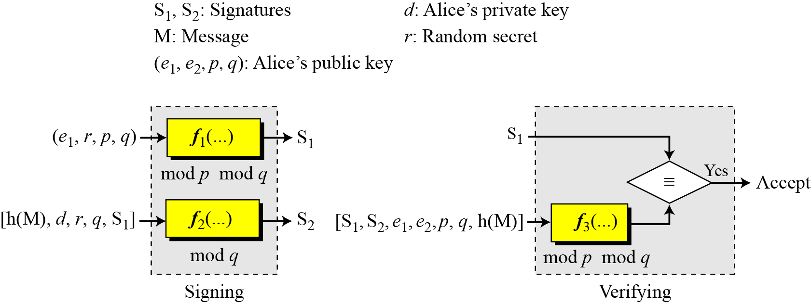
Digital Signature Standard (DSS)

Slide 27
Key Generation
Alice chooses primes p and q.
P is 1024 bit and q is 160 bit.
Alice creates e₁ to be the qth root of 1 modulo p.
Alice chooses d and calculates e₂ = e₁^{d}.
Alice’s public key is (e₁, e₂, p, q); her private key is (d).

Slide 28
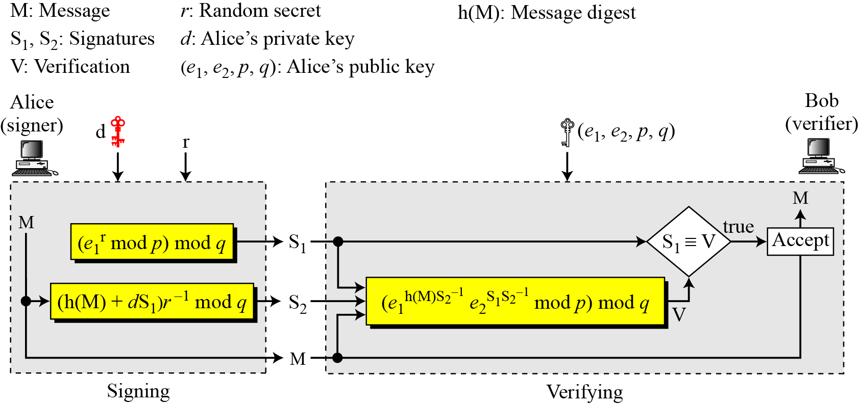
Verifying and Signing
DSS scheme

Slide 29
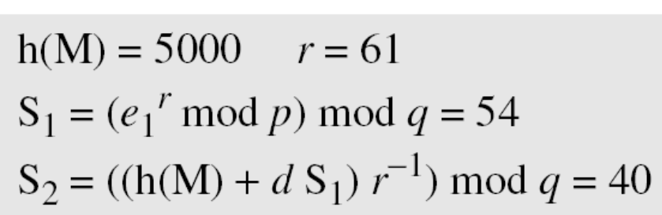

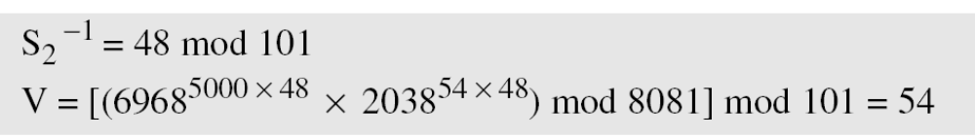
Example
Alice chooses q = 101 and p = 8081. Alice selects e₀ = 3 and calculates e¹ = e₀ ^{(p−1)/q} mod p = 6968. Alice chooses d = 61 as the private key and calculates e₂ = e₁^{d} mod p = 2038. Now Alice can send a message to Bob. Assume that h(M) = 5000 and Alice chooses r = 61:
Alice sends M, S₁, and S₂ to Bob. Bob uses the public keys to calculate V.

Slide 30
DIGITAL CERTIFICATE

Slide 31
What is a Digital Certificate?
A digital form of identification
  Similar to a passport or driver’s licence
  Binds subject’s public key (a mathematical value) to one or more attributes relating to their identity
A certificate is valid for a period of time, (often one, three or ten years)
Certificates can do different things. For example:
  Encrypt a document
  Sign a document – for non-repudiation
  Secure a WWW server
  Provide authentication - Enable the holder to access a corporate new work
Notes:
PVD
Explain attibutes -

Slide 32
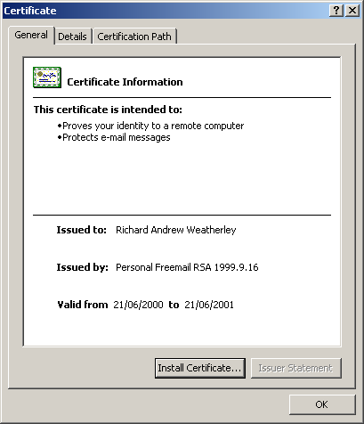
Example Certificate (1)

Slide 33
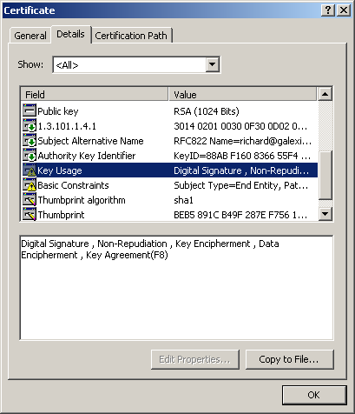
Example Certificate (2)
Certificate Attribute details : Key Usage

Slide 34
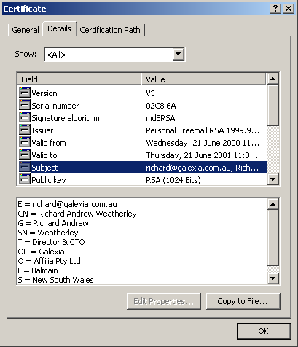
Example Certificate (3)
Certificate Attribute details : Subject

